Slide 1

PH0101 UNIT 4 LECTURE 2
MILLER INDICES
PROCEDURE FOR FINDING MILLER INDICES
DETERMINATION OF MILLER INDICES
IMPORTANT FEATURES OF MILLER INDICES
CRYSTAL DIRECTIONS
SEPARATION BETWEEN LATTICE PLANES

Slide 2
MILLER INDICES
The crystal lattice may be regarded as made
up of an infinite set of parallel equidistant
planes passing through the lattice points
which are known as lattice planes.
In simple terms, the planes passing through
lattice points are called ‘lattice planes’.
For a given lattice, the lattice planes can be
chosen in a different number of ways.

Slide 3
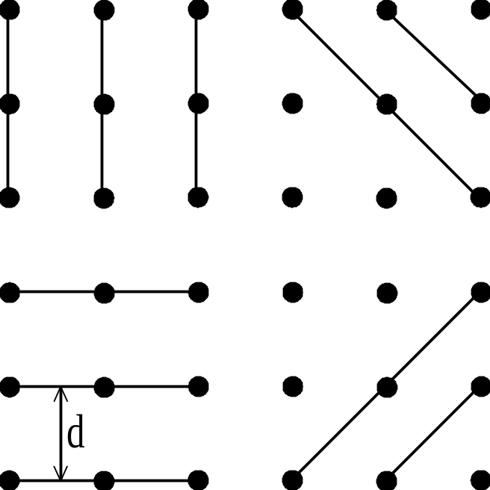
MILLER INDICES
DIFFERENT LATTICE PLANES

Slide 4
MILLER INDICES
The orientation of planes or faces in a crystal can be
described in terms of their intercepts on the three
axes.
Miller introduced a system to designate a plane in a
crystal.
He introduced a set of three numbers to specify a
plane in a crystal.
This set of three numbers is known as ‘Miller Indices’
of the concerned plane.

Slide 5

MILLER INDICES
Miller indices is defined as the reciprocals of
the intercepts made by the plane on the three
axes.

Slide 6
MILLER INDICES
Procedure for finding Miller Indices
Step 1: Determine the intercepts of the plane
along the axes X,Y and Z in terms of
the lattice constants a,b and c.
Step 2: Determine the reciprocals of these
numbers.

Slide 7
MILLER INDICES
Step 3: Find the least common denominator (lcd)
and multiply each by this lcd.
Step 4:The result is written in paranthesis.This is
called the `Miller Indices’ of the plane in
the form (h k l).
This is called the `Miller Indices’ of the plane in the form
(h k l).

Slide 8
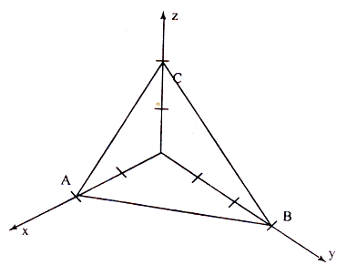
ILLUSTRATION
PLANES IN A CRYSTAL
Plane ABC has intercepts of 2 units along X-axis, 3
units along Y-axis and 2 units along Z-axis.

Slide 9
ILLUSTRATION
DETERMINATION OF ‘MILLER INDICES’
Step 1:The intercepts are 2,3 and 2 on the three axes.
Step 2:The reciprocals are 1/2, 1/3 and 1/2.
Step 3:The least common denominator is ‘6’.
Multiplying each reciprocal by lcd,
we get, 3,2 and 3.
Step 4:Hence Miller indices for the plane ABC is (3 2 3)

Slide 10
MILLER INDICES
IMPORTANT FEATURES OF MILLER INDICES
For the cubic crystal especially, the important features of Miller indices are,
A plane which is parallel to any one of the co-ordinate axes
has an intercept of infinity (∞). Therefore the Miller index for
that axis is zero; i.e. for an intercept at infinity, the
corresponding index is zero.

Slide 11
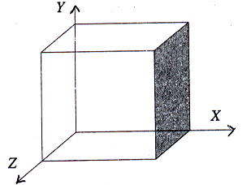
EXAMPLE
( 1 0 0 ) plane
Plane parallel to Y and Z axes

Slide 12
EXAMPLE
In the above plane, the intercept along X axis is 1 unit.
The plane is parallel to Y and Z axes. So, the intercepts
along Y and Z axes are ‘∞’.
Now the intercepts are 1, ∞ and ∞.
The reciprocals of the intercepts are = 1/1, 1/∞ and 1/∞.
Therefore the Miller indices for the above plane is (1 0 0).

Slide 13
MILLER INDICES
IMPORTANT FEATURES OF MILLER INDICES
A plane passing through the origin is defined in terms of a
parallel plane having non zero intercepts.
All equally spaced parallel planes have same ‘Miller
indices’ i.e. The Miller indices do not only define a particular
plane but also a set of parallel planes. Thus the planes
whose intercepts are 1, 1,1; 2,2,2; -3,-3,-3 etc., are all
represented by the same set of Miller indices.

Slide 14
MILLER INDICES
IMPORTANT FEATURES OF MILLER INDICES
It is only the ratio of the indices which is important in this
notation. The (6 2 2) planes are the same as (3 1 1) planes.
If a plane cuts an axis on the negative side of the origin,
corresponding index is negative. It is represented by a bar,
like (1 0 0). i.e. Miller indices (1 0 0) indicates that the
plane has an intercept in the –ve X –axis.

Slide 15
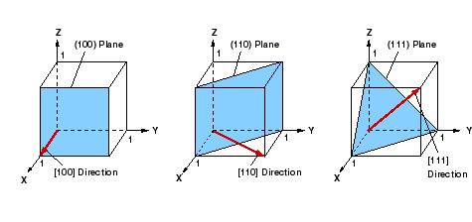
MILLER INDICES OF SOME IMPORTANT PLANES

Slide 16
PROBLEMS
Worked Example:
A certain crystal has lattice parameters of 4.24, 10 and 3.66 Å on X, Y, Z axes respectively. Determine the Miller indices of a plane having intercepts of 2.12, 10 and 1.83 Å on the X, Y and Z axes.
Lattice parameters are = 4.24, 10 and 3.66 Å
The intercepts of the given plane = 2.12, 10 and 1.83 Å
i.e. The intercepts are, 0.5, 1 and 0.5.
Step 1: The Intercepts are 1/2, 1 and 1/2.
Step 2: The reciprocals are 2, 1 and 2.
Step 3: The least common denominator is 2.
Step 4: Multiplying the lcd by each reciprocal we get, 4, 2 and 4.
Step 5: By writing them in parenthesis we get (4 2 4)
Therefore the Miller indices of the given plane is (4 2 4) or (2 1 2).

Slide 17
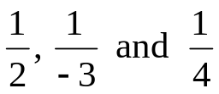

PROBLEMS
Worked Example:
Calculate the miller indices for the plane with intercepts 2a, - 3b and 4c the along the crystallographic axes.
The intercepts are 2, - 3 and 4
Step 1: The intercepts are 2, -3 and 4 along the 3 axes
Step 2: The reciprocals are
Step 3: The least common denominator is 12.
Multiplying each reciprocal by lcd, we get 6 -4 and 3
Step 4: Hence the Miller indices for the plane is

Slide 18
CRYSTAL DIRECTIONS
In crystal analysis, it is essential to indicate certain
directions inside the crystal.
A direction, in general may be represented in terms of
three axes with reference to the origin.In crystal system,
the line joining the origin and a lattice point represents
the direction of the lattice point.

Slide 19
CRYSTAL DIRECTIONS
To find the Miller indices of a direction,
Choose a perpendicular plane to that direction.
Find the Miller indices of that perpendicular plane.
The perpendicular plane and the direction have
the same Miller indices value.
Therefore, the Miller indices of the perpendicular
plane is written within a square bracket to
represent the Miller indices of the direction like [ ].

Slide 20
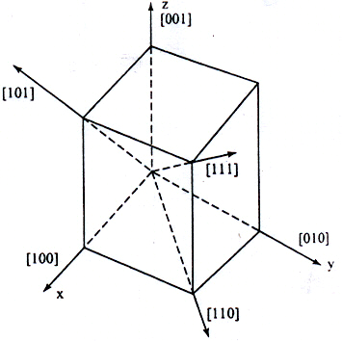
IMPORTANT DIRECTIONS IN CRYSTAL

Slide 21
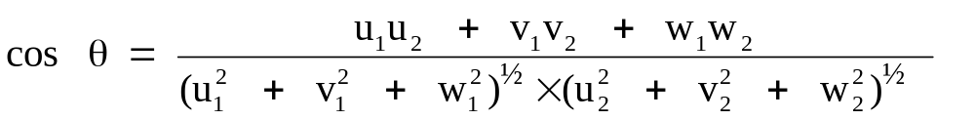
PROBLEMS
Worked Example
Find the angle between the directions [2 1 1] and [1 1 2] in a cubic crystal.
The two directions are [2 1 1] and [1 1 2]
We know that the angle between the two directions,

Slide 22
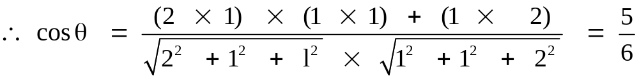
PROBLEMS
In this case, u₁ = 2, v₁ = 1, w₁ = 1, u₂ = 1, v₂ = 1, w₂ = 2
(or) cos θ = 0.833
θ = 35° 35′30′′.

Slide 23
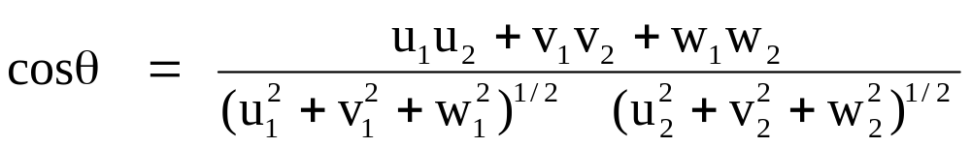
DESIRABLE FEATURES OF MILLER INDICES
The angle ‘θ’ between any two crystallographic directions
[u₁ v₁ w₁] and [u₂ v₂ w₂] can be calculated easily. The
angle ‘θ’ is given by,
The direction [h k l] is perpendicular to the plane (h k l)

Slide 24
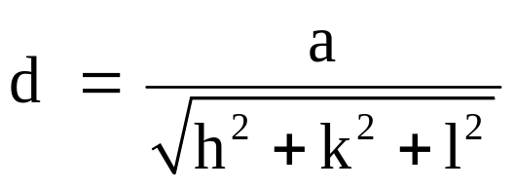
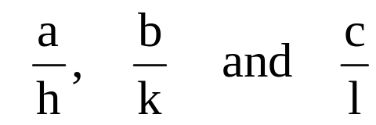
DESIRABLE FEATURES OF MILLER INDICES
The relation between the interplanar distance and the
interatomic distance is given by,
for cubic crystal.
If (h k l) is the Miller indices of a crystal plane then the
intercepts made by the plane with the crystallographic
axes are given as
where a, b and c are the primitives.

Slide 25
SEPARATION BETWEEN LATTICE PLANES
Consider a cubic crystal of side ‘a’, and a
plane ABC.
This plane belongs to a family of planes
whose Miller indices are (h k l) because
Miller indices represent a set of planes.
Let ON =d, be the perpendicular distance of
the plane A B C from the origin.

Slide 26
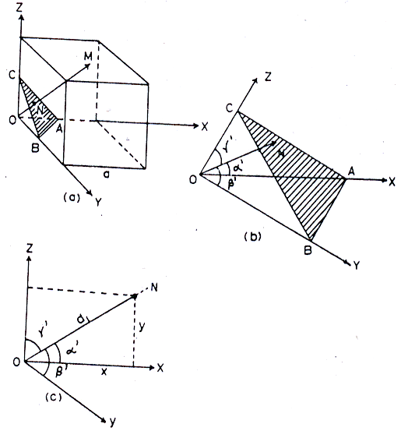
SEPARATION BETWEEN LATTICE PLANES

Slide 27
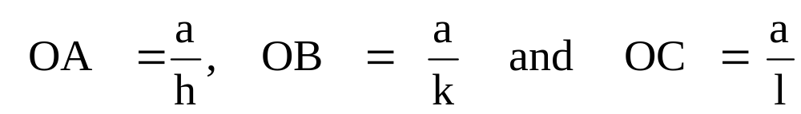
SEPARATION BETWEEN LATTICE PLANES
Let α₁, β₁ and γ₁ (different from the interfacial
anglesα, β and γ) be the angles between co-
ordinate axes X,Y,Z and ON respectively.
The intercepts of the plane on the three axes are,
(1)

Slide 28
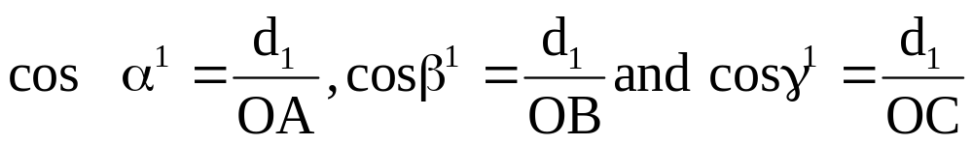
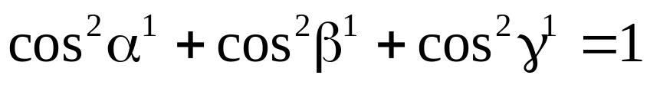
SEPARATION BETWEEN LATTICE PLANES
From the figure, 4.14(a), we have,
(2)
From the property of direction of cosines,
(3)
Using equation 1 in 2, we get,

Slide 29
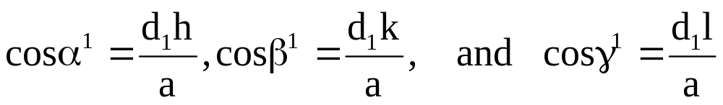
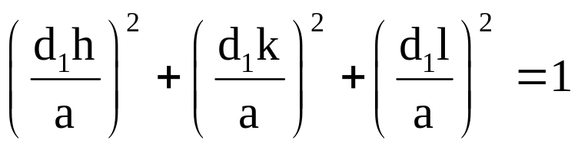
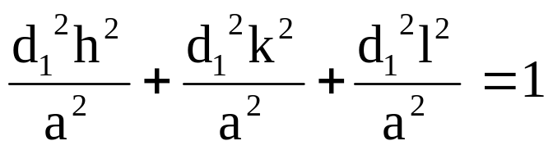
SEPARATION BETWEEN LATTICE PLANES
Using equation 1 in 2, we get,
(4)
Substituting equation (4) in (3), we get,

Slide 30
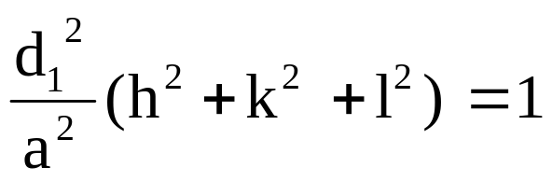
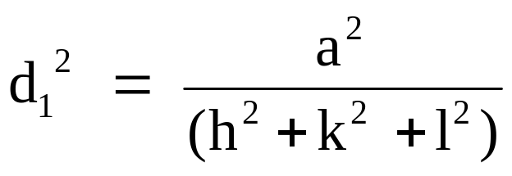
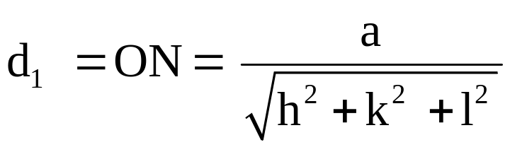
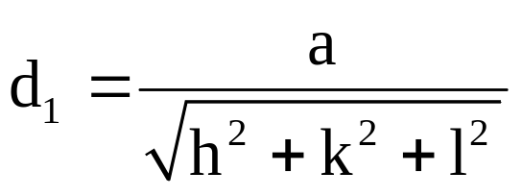
i.e.
(5)
i.e. the perpendicular distance between the origin
and the 1st plane ABC is,

Slide 31
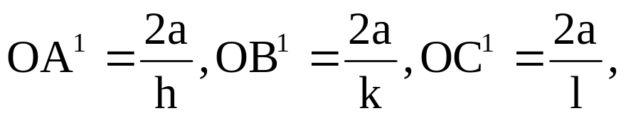
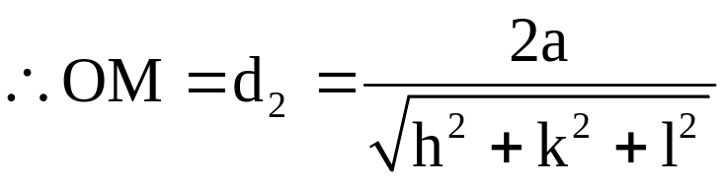
Now, let us consider the next parallel plane.
Let OM=d₂ be the perpendicular distance of this
plane from the origin.
The intercepts of this plane along the three axes are

Slide 32
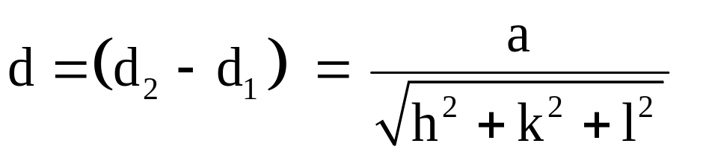
SEPARATION BETWEEN LATTICE PLANES
Therefore, the interplanar spacing between two
adjacent parallel planes of Miller indices (h k l ) is
given by, NM = OM – ON
i.e.Interplanar spacing
(6)

Slide 33
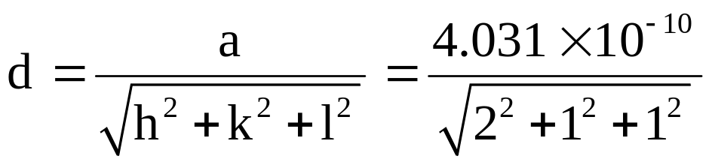
PROBLEMS
Worked Example
The lattice constant for a unit cell of aluminum is 4.031Å Calculate the interplanar space of (2 1 1) plane.
a = 4.031 Å
(h k l) = (2 1 1)
Interplanar spacing
∴ d = 1.6456 Å

Slide 34
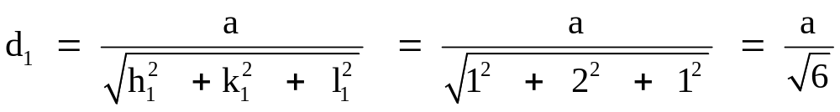
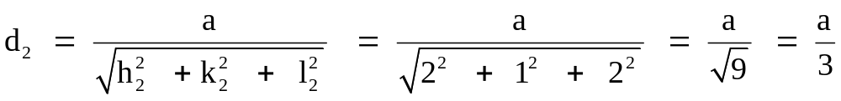
PROBLEMS
Worked Example:
Find the perpendicular distance between the two planes indicated by the Miller indices (1 2 1) and (2 1 2) in a unit cell of a cubic lattice with a lattice constant parameter ‘a’.
We know the perpendicular distance between the origin and the plane is (1 2 1)
and the perpendicular distance between the origin and the plane (2 1 2),

Slide 35
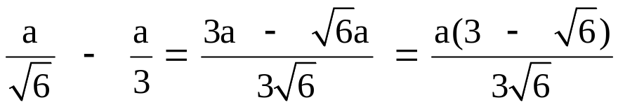
PROBLEMS
The perpendicular distance between the planes (1 2 1) and (2 1 2) are,
d = d₁ – d₂ =
(or) d = 0.0749 a.

Slide 36
Physics is hopefully simple but Physicists are not

